Slide 1
FlappyBrainTeam
Garnet Crookes
Mohammed Alhajjaj
Derek Walz

Slide 2

Problem Statement
Enabling those with mobility limitations to participate with today’s complex computer interface requirements
Problem Statement
Solution
Implementation
Implementation

Slide 3
Solution
Utilize BCI tools allowing users to control computer mouse movements through EOG readings
User has full two-dimensional motion with clicking capability
Potential to widen implementation to other applications requiring 4+ standard control inputs
Problem Statement
Solution
Implementation
Implementation

Slide 4
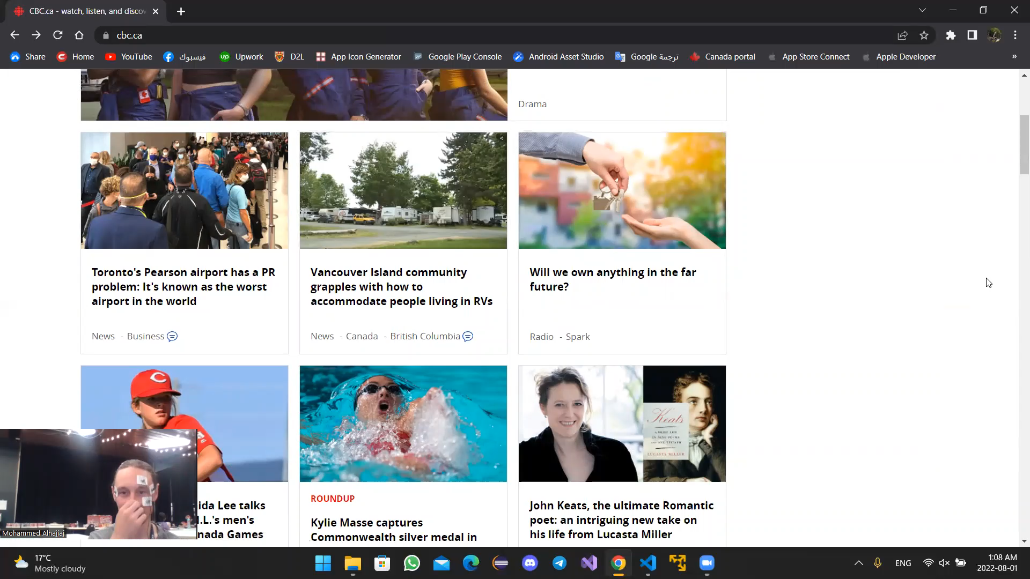
Showcase
Problem Statement
Solution
Showcase
Implementation

Slide 5
Video Link
video tutorial for EOG mouse control - YouTube
Problem Statement
Solution
Implementation
Implementation

